Slide 1

Building an client Online Library
Website: An Overview of HTML , CSS, JavaScript, Node.js, and MongoDB Integration:
Om Patel 16
Shreyas Kalate 23
Sushain Devi 25
Dev Desai 29

Slide 2

Introduction
Online library issue system—a convergence of advanced technologies and design principles.
This project harmoniously incorporates HTML, CSS, JavaScript, Node.js, and MongoDB to deliver a sophisticated and user-centric digital library experience.

Slide 3
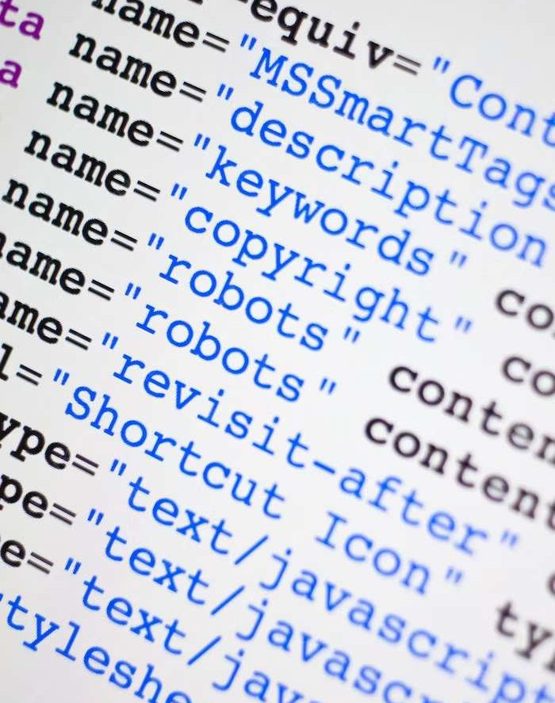
HTML Basics
At the core of our digital architecture lies HTML, meticulously employed to structure and organize our online library. This foundational language is instrumental in creating a seamless and intuitive user interface. From the structural integrity of headers to the intricacies of form elements, HTML forms the basis of our digital landscape.

Slide 4
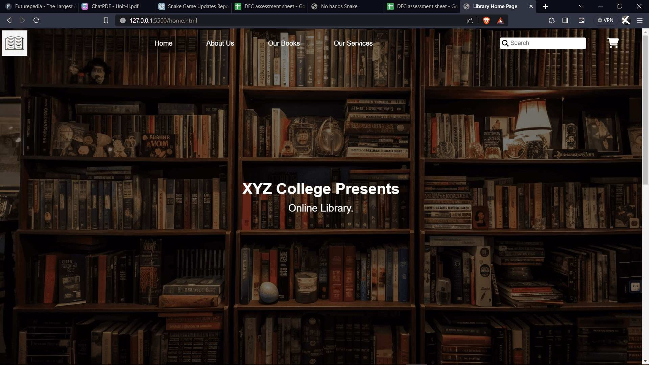

Slide 5

CSS Styling
Elevating aesthetics to a paramount level, CSS plays a pivotal role in shaping the visual identity of our online library. Through meticulous styling, we have imbued the interface with a harmonious blend of colors, fonts, and layouts, enhancing the user experience and fostering engagement.

Slide 6
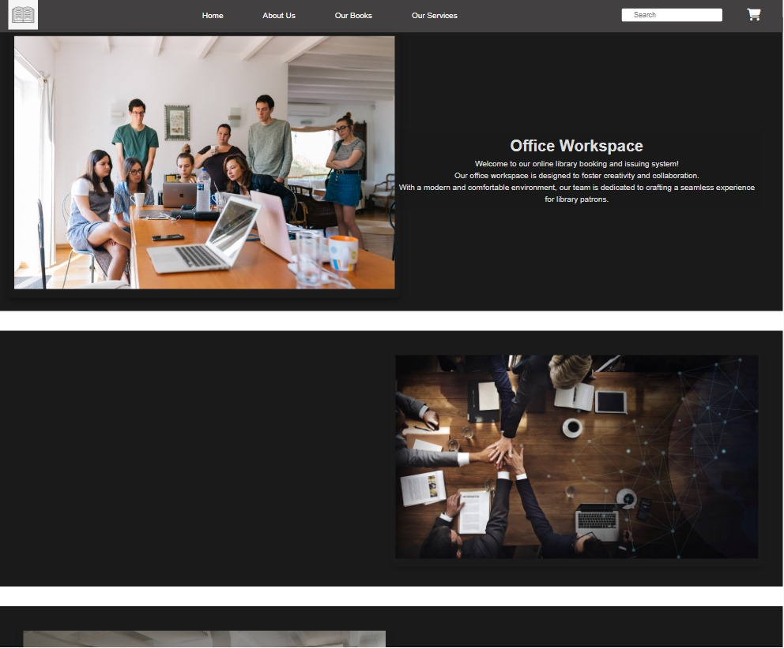

Slide 7

JavaScript Functionality
Beyond mere aesthetics, the functionality of our system is orchestrated by JavaScript. This dynamic scripting language empowers our digital library with interactive features, real-time updates, and seamless user interactions. JavaScript ensures a responsive and immersive experience for our users.

Slide 8
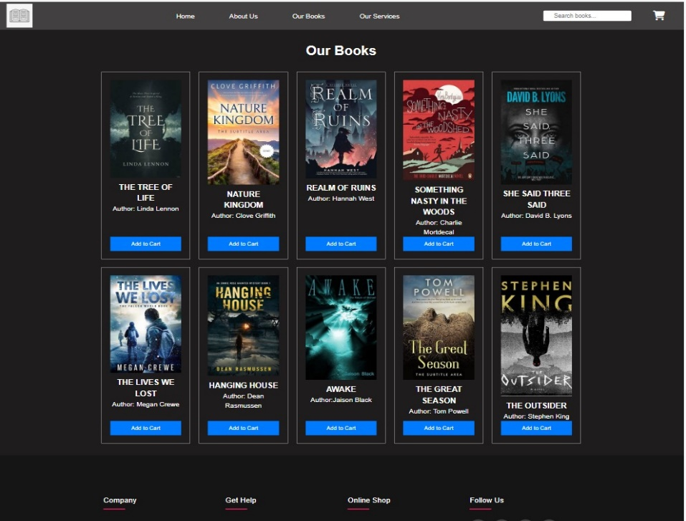

Slide 9

Node.js Integration
Transitioning to the server-side paradigm, Node.js assumes a central role in our project. This runtime environment facilitates the execution of server-side scripts, adeptly handling requests and managing data flow. Node.js ensures the stability and responsiveness of our online library.

Slide 10
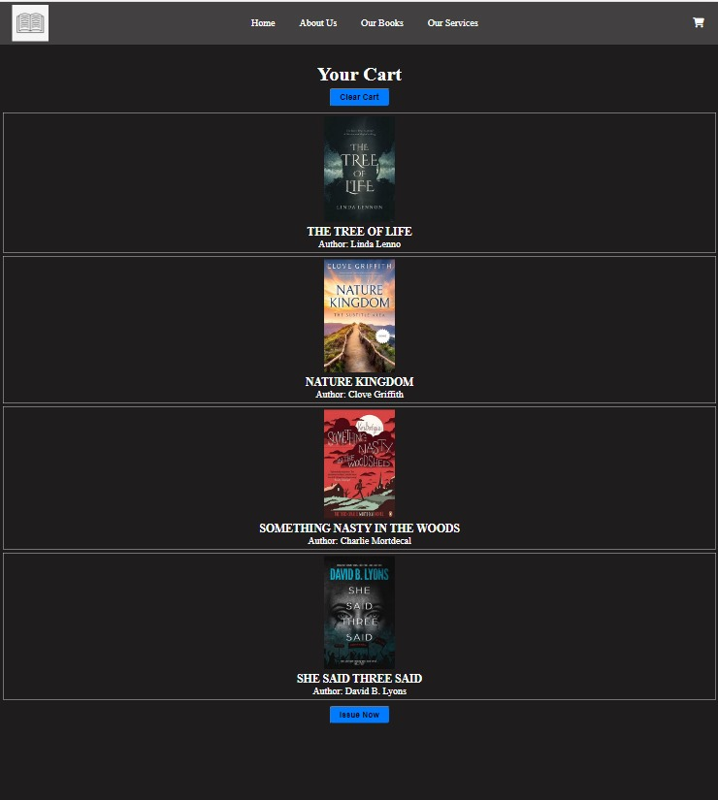

Slide 11

MongoDB Database
In the realm of data management, MongoDB takes center stage. The seamless integration of this NoSQL database allows for efficient storage and retrieval of book data. Its scalability and flexibility afford us the capability to adapt to the evolving demands of our digital library seamlessly.

Slide 12
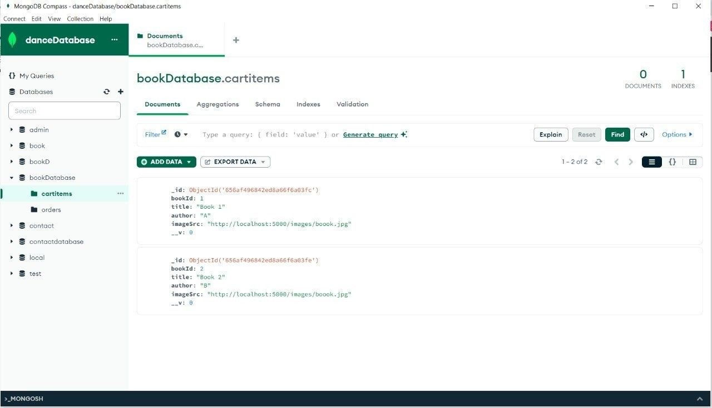

Slide 13

Optimizing Performance
The pursuit of optimal performance is foundational to our project. Rigorous strategies have been employed to minimize load times and streamline database queries. Every facet of our online library has been meticulously optimized to deliver a seamless and gratifying user experience.

Slide 14
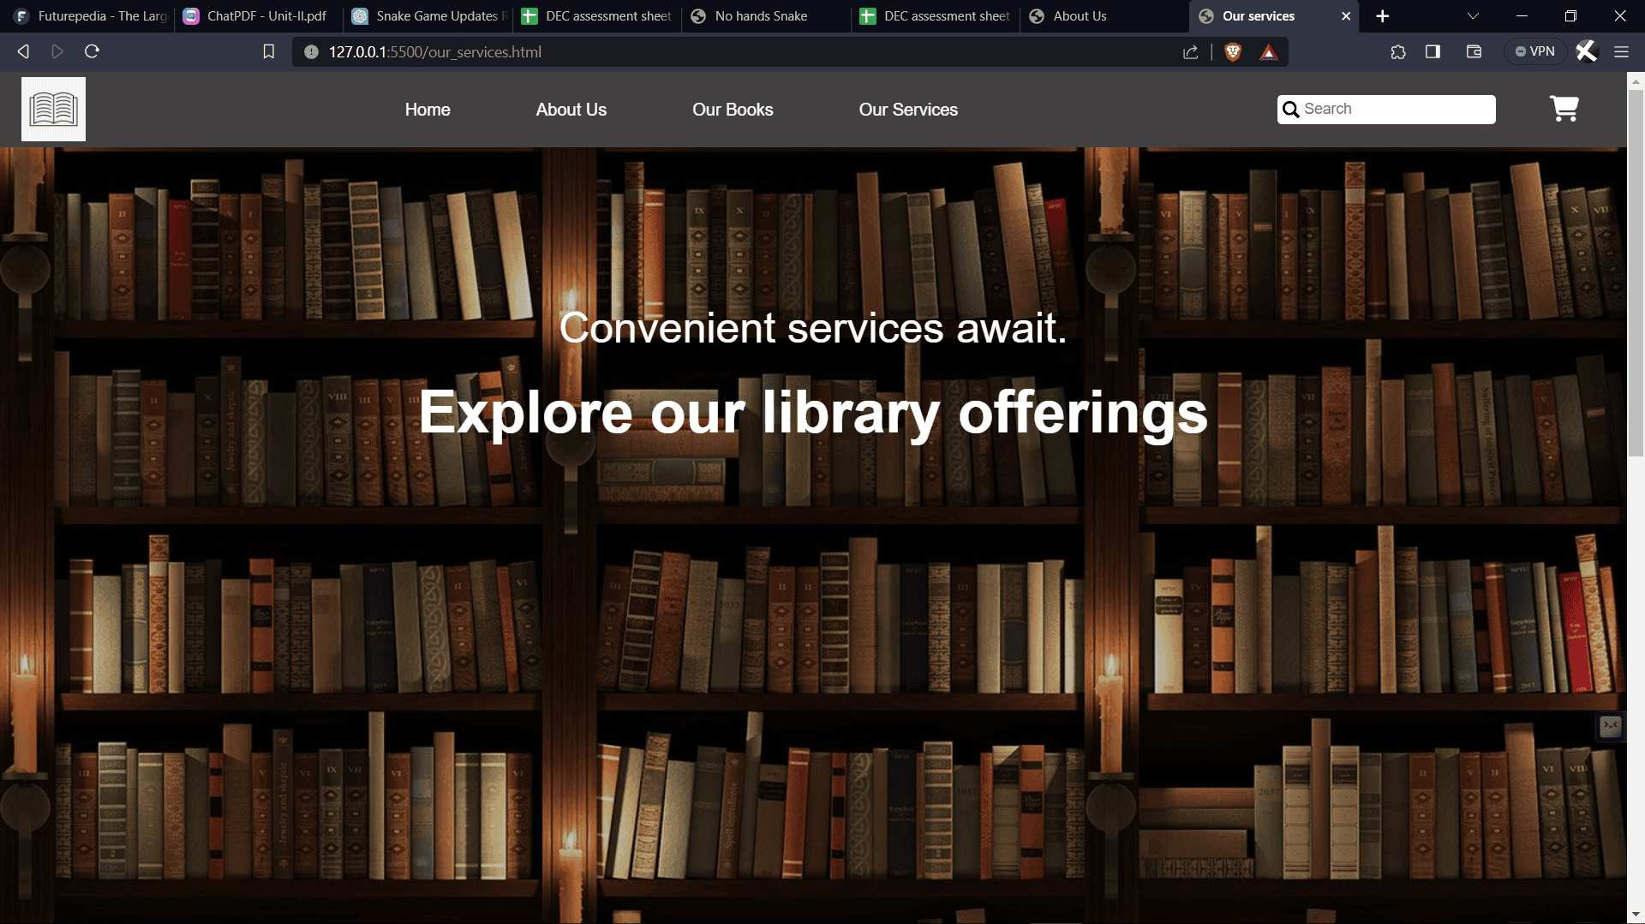

Slide 15
Conclusion
In summary, our online library issue system seamlessly integrates HTML, CSS, JavaScript, Node.js, and MongoDB to create a sophisticated user experience. From the foundational structure to aesthetic refinement, each component plays a crucial role. The server-side prowess of Node.js ensures responsiveness, while MongoDB's efficiency manages our extensive book database. Meticulous performance optimization underscores our commitment to excellence
,

Slide 16



Thanks!

